Slide 1
Data Preprocessing

Slide 2
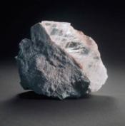
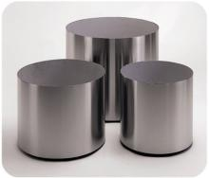
Outline
Data Cleansing
Data Transformation
Data Description
Feature Selection
Feature Extraction
Notes:
数据不能直接分析，需要预处理

Slide 3
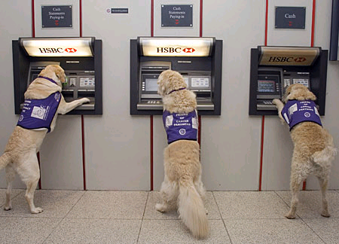

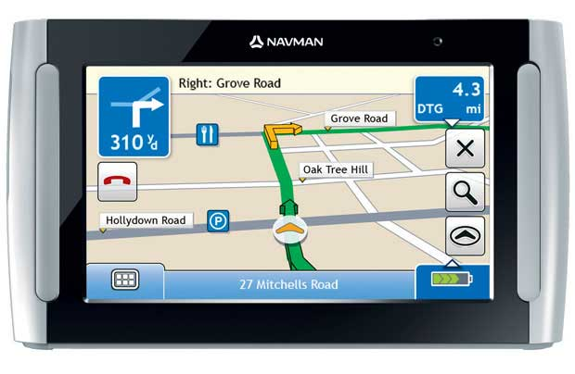

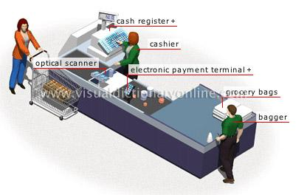
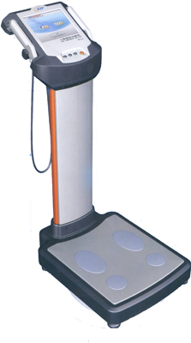
Where are data from?

Slide 4
Why Data Preprocessing?
Real data are notoriously dirty!
The biggest challenge in many data mining projects
Incomplete
Occupancy = “ ”
Noisy
Salary = “-100”
Inconsistent
Age = “42” vs. Birthday = “01/09/1985”
Redundant
Too much data or too many features for analytical analysis
Others
Data types
Imbalanced datasets
Notes:
notoriously
adv.恶名昭彰地；声名狼藉地; 著名地；众所周知地;
occupancy英[ˈɒkjəpənsi]美[ˈɑːkjəpənsi]
n.(房屋、土地等的)占用，使用，居住;

Slide 5

Missing Data
Data are not always available
One or more attributes of a sample may have empty values
Many data mining algorithms cannot handle missing values directly
May cause significant troubles
Possible Reasons
Equipment malfunction
Data not provided
Not Applicable (N/A)
Different Types
Missing completely at random
Missing conditionally at random
Not missing at random
Notes:
not applicable不适用; 缩写词为NA

Slide 6
How to handle missing data?
Ignore
Remove samples/attributes with missing values
The easiest and most straightforward way
Work well with low missing rates
Fill in the missing values manually
Recollect the data
Domain knowledge
Tedious/Infeasible
Fill in the missing values automatically
A global constant
The mean or median
Most probable values
More art than science
Notes:
tedious英[ˈtiːdiəs]美[ˈtiːdiəs]
adj.冗长的; 啰唆的; 单调乏味的; 令人厌烦的;
infeasible美[ɪnˈfizəbəl]
adj.不能实行的；不可能的；办不到的;

Slide 7
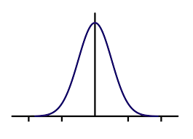
Missing Data: An Example
P(Y|X)
M_Y
Y
M_Y
M_Y
X
Notes:
工作时间，收入比
工作越长 收入越少

Slide 8
Outliers
Outliers
y
y = x + 1
x
Notes:
外点，离群点

Slide 9

Outliers
Outliers

Slide 10

Anomaly vs. Outlier
Notes:
姚明，相对
anomaly英[əˈnɒməli]美[əˈnɑːməli]
n.异常事物; 反常现象;

Slide 11
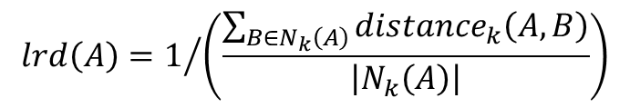
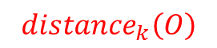
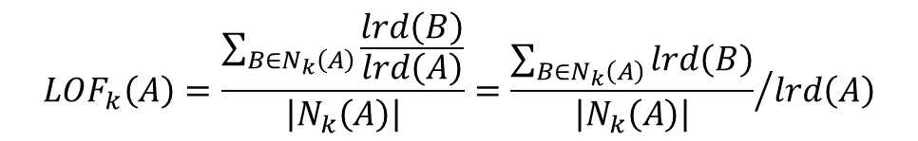
Local Outlier Factor
$${distance}_{k}\left(O\right)$$
k=3
p₂
o
p₁
$${distance}_{k}\left(A,B\right)=max\left\{{distance}_{k}\left(B\right),d\left(A,B\right)\right\}$$
p₃
p₄
$$lrd\left(A\right)=1/{\left(\frac{\sum_{B∈N_{k}\left(A\right)}{{distance}_{k}\left(A,B\right)}}{\left|N_{k}\left(A\right)\right|}\right)}$$
$${LOF}_{k}\left(A\right)=\frac{\sum_{B∈N_{k}\left(A\right)}{\frac{lrd\left(B\right)}{lrd\left(A\right)}}}{\left|N_{k}\left(A\right)\right|}={\frac{\sum_{B∈N_{k}\left(A\right)}{lrd\left(B\right)}}{\left|N_{k}\left(A\right)\right|}}/{lrd\left(A\right)}$$
Notes:
k 近邻

Slide 12
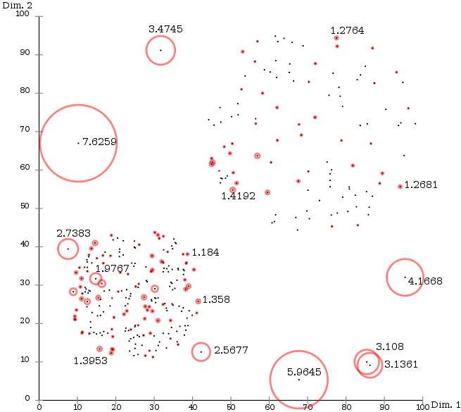
Local Outlier Factor

Slide 13
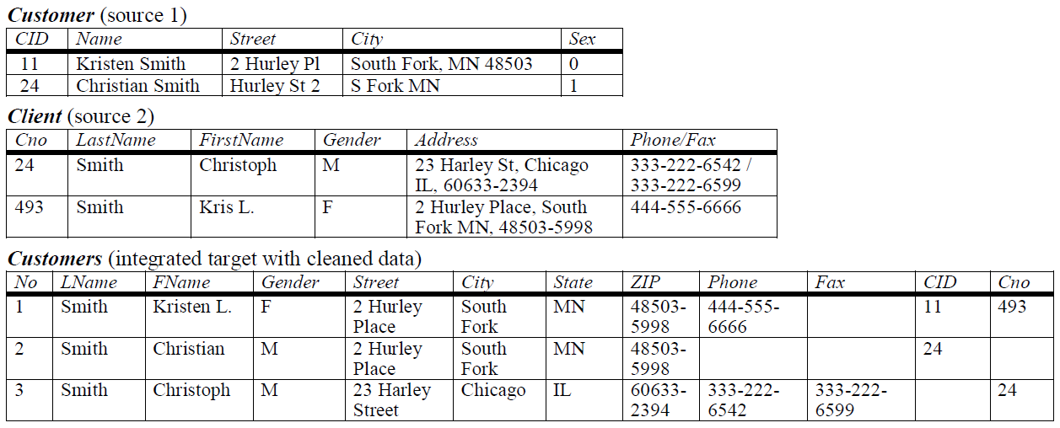
Duplicate Data
Notes:
冗余
customer英[ˈkʌstəmə(r)]美[ˈkʌstəmər]
n.顾客; 客户; 主顾; (用于形容词之后描述某类型的人)家伙; client英[ˈklaɪənt]美[ˈklaɪənt]
n.客户; 当事人; 委托人; (连接在服务器上的)客户机;

Slide 14
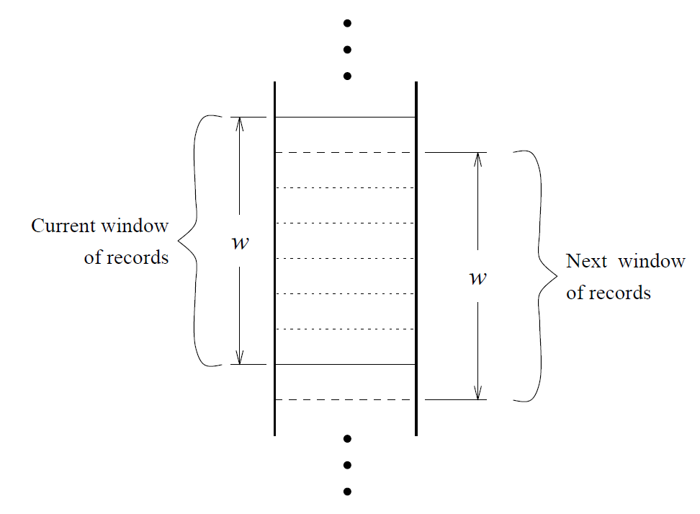
Duplicate Data

Slide 15
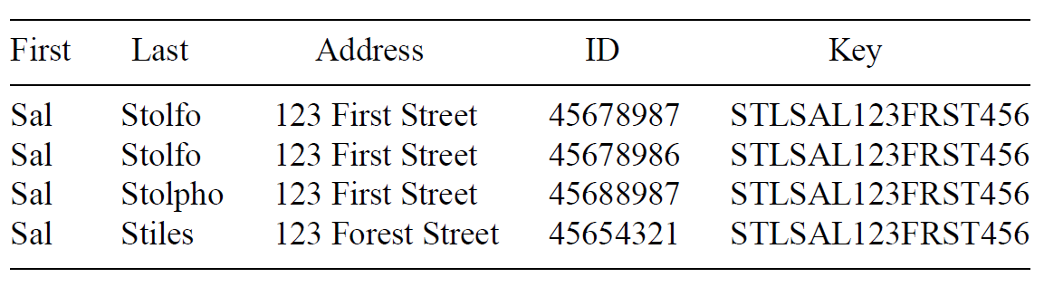
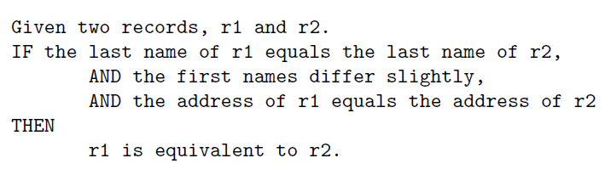
Duplicate Data
Create Keys
Sort
Merge
Notes:
名 姓
中外区别

Slide 16
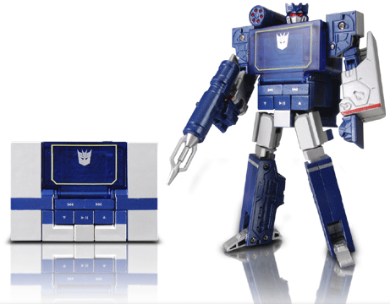
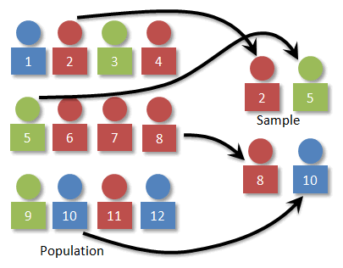
Data Transformation
Now we have an error free dataset
Still needs to be standardized
Type Conversion
Normalization
Sampling
Notes:
数据变换

Slide 17
Attribute Types
Continuous
Real values: Temperature, Height, Weight …
Discrete
Integer values: Number of people …
Ordinal
Rankings: {Average, Good, Best}, {Low, Medium, High} …
Nominal
Symbols: {Teacher, Worker, Salesman}, {Red, Green, Blue} …
String
Text: “Peking University”, “No. 5, Yiheyuan Street” …
Notes:
ordinal英[ˈɔːdɪnl]美[ˈɔːrdənl]
n.序数词(如第一、第二等);adj.序数的
nominal英[ˈnɒmɪnl]美[ˈnɑːmɪnl]
adj.名义上的; 有名无实的; 很小的; 象征性的; 名词性的; 名词的;n.名词性词;

Slide 18
Type Conversion
×
○
×
×
○
×
Size
○
×
○
○
×
○
Color
Notes:
水果 颜色 大小
分界面

Slide 19
Type Conversion
×
×
○
×
×
○
Size
○
○
×
○
○
×
Color
Notes:
距离 不确定

Slide 20
Type Conversion
0 0 0 1
0 0 1 0
0 1 0 0
1 0 0 0
Notes:
独热编码(One-Hot Encoding)
向量距离相等

Slide 21
Sampling
A database/data warehouse may store terabytes of data
Processing limits: CPU, Memory, I/O …
Sampling is applied to reduce the time complexity
In statistics, sampling is applied often because obtaining the entire set of data is expensive
Aggregation
Change of scale:
Cities → States; Days → Months
More stable and less variability
Sampling can be also used to adjust the class distributions
Imbalanced dataset
Notes:
terabyte
美 [ˈterəˌbaɪt]
英 ['terə.baɪt]
n.万亿字节
网络太字节；兆兆字节；兆位元组
复数：terabytes
权威英汉双解
英汉
英英
网络释义
terabyte
n.
1.
万亿字节，太字节（十进制计算机内存或数据的单位，等于 1 000 000 000 000 字节）a unit of computer memory or data, equal to one million million, or 10¹²(= 1 000 000 000 000) bytes
2.
太字节（二进制计算机内存或数据的单位，等于 1 099 511 627 776 字节）a unit of computer memory or data, equal to 2⁴⁰(= 1 099 511 627 776) bytes
aggregation英[ˌæɡrɪˈɡeɪʃn]美[ˌæɡrɪˈɡeɪʃn]
n.聚集，集合，聚集体；
variability英[ˌveəriəˈbɪləti]美[ˌveriəˈbɪləti]
n.可变性; 易变性; 反复不定;

Slide 22
Imbalanced Datasets
LHS RHS
10%
5%
85%
Classifier A
Classifier B
Notes:
表示数据图表上左右两边都有数轴时，某组数据是“左轴”或“右轴”的，也就是要对照左边或右边的这根数轴。 或者，left hand side 公式左边，right hand side 公式右边

Slide 23

Confusion Matrix
Confusion Matrix
 |  | Actual Value
 |  | Positive | Negative | Total
Predicted Value | Positive | True Positive | False Positive | P'
 | Negative | False Negative | True Negative | N'
Total |  | P | N
TPR=TP/(TP+FN)
TNR=TN/(TN+FP)
Accuracy=(TP+TN)/(P+N)

Slide 24
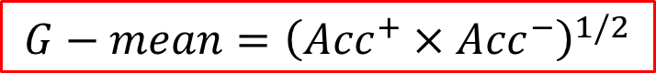
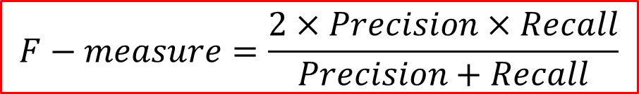
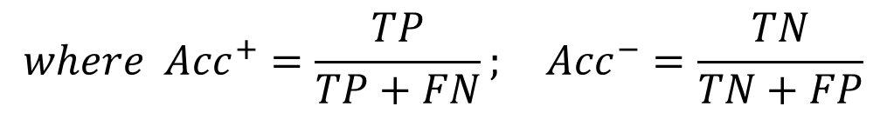
Imbalanced Datasets
Confusion Matrix
 |  | Actual Value
 |  | Positive | Negative | Total
Predicted Value | Positive | True Positive | False Positive | P'
 | Negative | False Negative | True Negative | N'
Total |  | P | N
$$G−mean={\left({Acc}^{+}×{Acc}^{−}\right)}^{1/2}$$
$$where {Acc}^{+}=\frac{TP}{TP+FN}; {Acc}^{−}=\frac{TN}{TN+FP}$$
$$F−measure=\frac{2×Precision×Recall}{Precision+Recall}$$
$$where Precision=\frac{TP}{TP+FP}; Recall=\frac{TP}{TP+FN}={Acc}^{+}$$

Slide 25
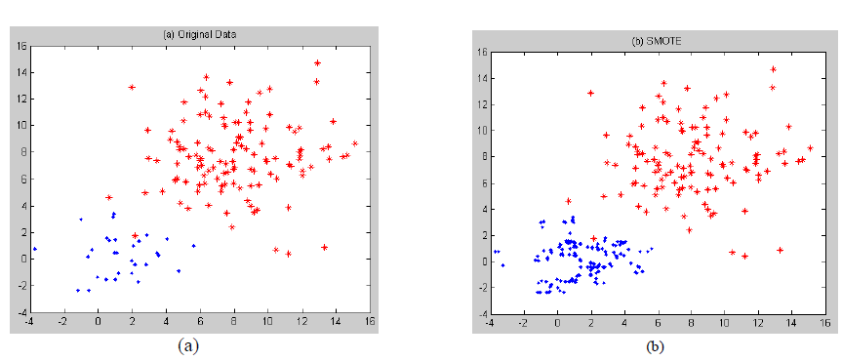
Over-Sampling
SMOTE
Notes:
上采样， 过采样

Slide 26
Boundary Sampling

Slide 27
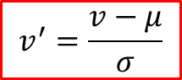
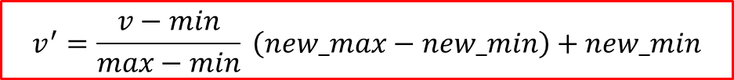
Normalization
The height of someone can be 1.7 or 170 or 1700 …
Min-max normalization:
Let income range $12,000 to $98,000 be normalized to [0.0, 1.0]. Then $73,600 is mapped to
Z-score normalization (μ: mean, σ: standard deviation):
Let μ = 54,000, σ = 16,000. Then
$$v^{′}=\frac{v−min}{max−min} \left(new_max−new_min\right)+new_min$$
$$v^{′}=\frac{v−μ}{σ}$$
Notes:
零均值归一化(Z-Score Normalization) 也称为标准化分数,根据原始数据的均值和标准差将数据映射到均值为0,标准差为1的分布.

Slide 28
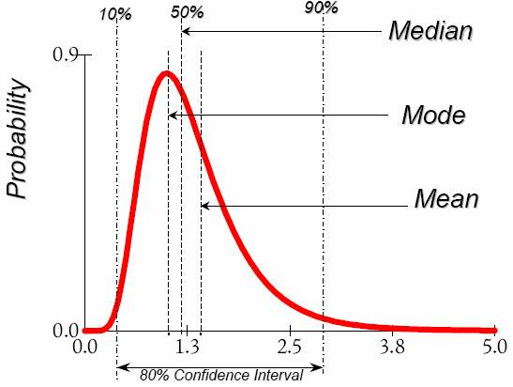
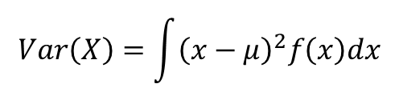
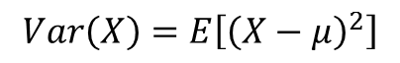
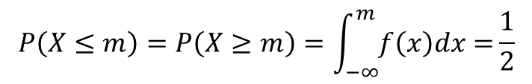
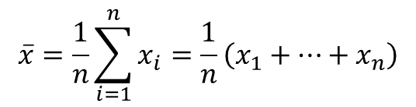
Data Description
Mean
Arithmetic mean
Median
Mode
The most frequently occurring value in a list
Can be used with non-numerical data.
Variance
Degree of diversity
$$\overline{x}=\frac{1}{n}\sum_{i=1}^{n}{x_{i}}=\frac{1}{n}\left(x_{1}+…+x_{n}\right)$$
$$P\left(X≤m\right)=P\left(X≥m\right)=\int_{−∞}^{m}{f\left(x\right)dx=}\frac{1}{2}$$
$$Var\left(X\right)=\int{{\left(x−μ\right)}^{2}f\left(x\right)dx}$$
$$Var\left(X\right)=E\left[{\left(X−μ\right)}^{2}\right]$$
Notes:
算术平均数（ arithmetic mean），又称均值
中位数
众数Mode频度最大的那个数
方差 差异性

Slide 29
Data Description
Pearson’s product moment correlation coefficient
If r_{A, B} > 0, A and B are positively correlated.
If r_{A, B} = 0, no linear correlation between A and B.
If r_{A, B} < 0, A and B are negatively correlated.

Slide 30
Data Description
Pearson's chi-square (χ²) test
 | Play chess | Not play chess | Sum (row)
Like science fiction | 250 (90) | 200 (360) | 450
Not like science fiction | 50 (210) | 1000 (840) | 1050
Sum (col.) | 300 | 1200 | 1500
Notes:
皮尔森卡方检验（英语：Pearson's chi-squared test）是最有名卡方检验之一（其他常用的卡方检验还有叶氏连续性校正、似然比检验、一元混成检验等等，它们的统计值之机率分配都近似于卡方分配，故称卡方检验）。

Slide 31
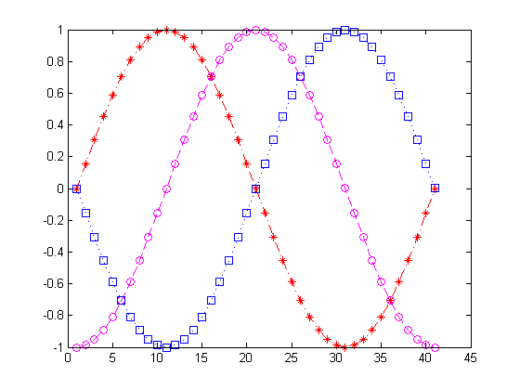
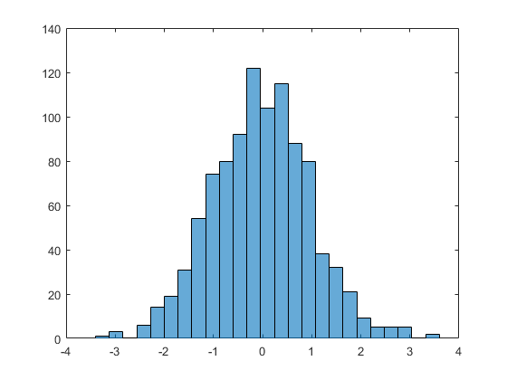
Data Visualization (1D)

Slide 32
Data Visualization (2D)
Notes:
排量 加速度
load carsmall
plot(Displacement, Acceleration,'ro')
regress(Acceleration,[ones(100,1),Displacement])
hold on
line([0,19.35/0.021],[19.35,0])

Slide 33
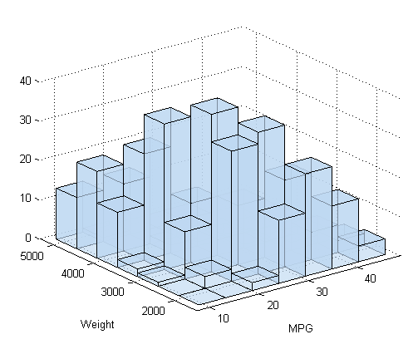
Surf Plots (3D)
Notes:
[X,Y]=meshgrid(-3:0.1:3,-3:0.1:3);
Z=peaks(X,Y);
surfc(X,Y,Z);
shading interp
colormap(gray);

Slide 34
Box Plots (High Dimensional)
Notes:
高维 4维
S=diag([1,2,0.5,1])
M=[0,1,3,-1];
Z=mvnrnd(M,S,10000);
boxplot(Z);

Slide 35
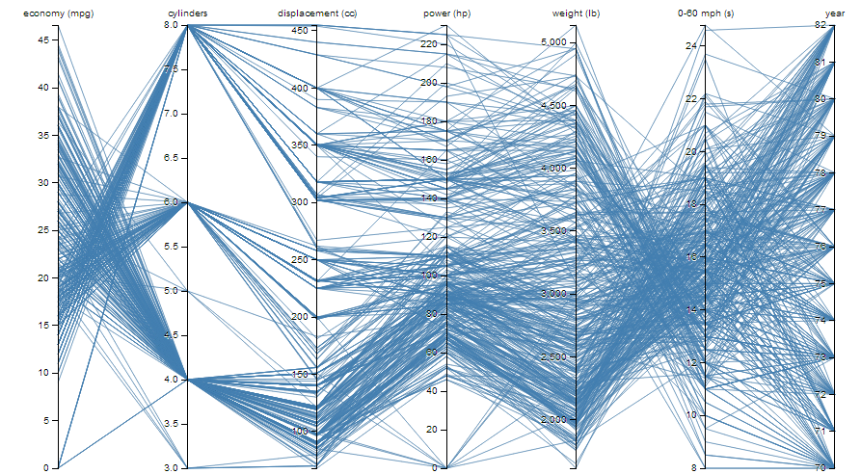
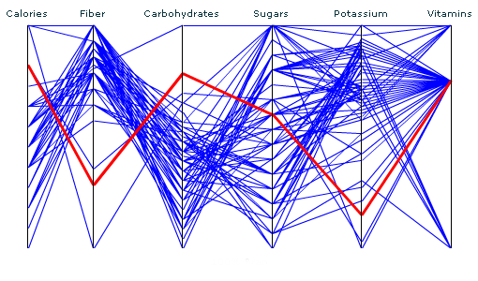
Parallel Coordinates (High Dimensional)
Notes:
平行坐标 高维

Slide 36
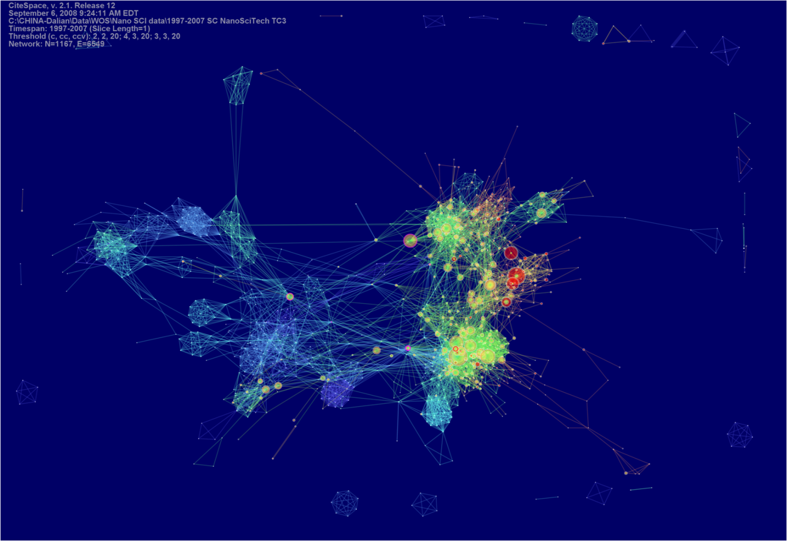
CiteSpace
Notes:
学术，文献引用 专利

Slide 37
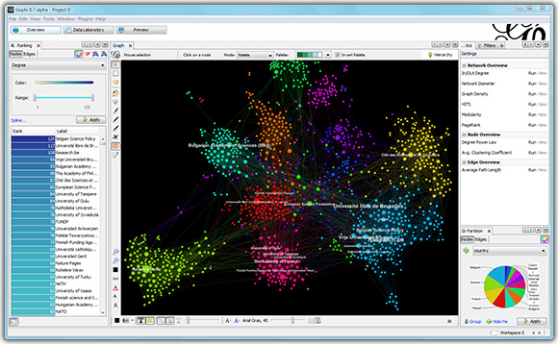
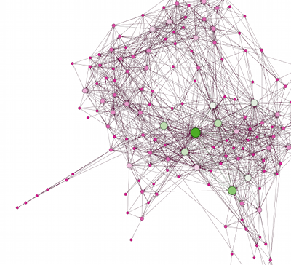
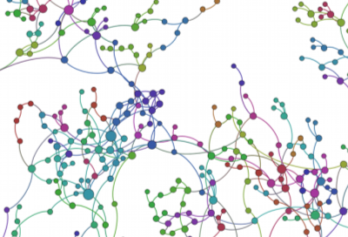
Gephi
Notes:
网络，图结构
Gephi是一款开源免费跨平台基于JVM的复杂网络分析软件，其主要用于各种网络和复杂系统，动态和分层图的交互可视化与探测开源工具。

Slide 38
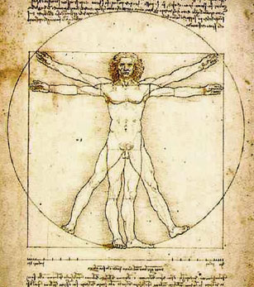
Feature Selection
ID
Weight
Age
Noisy?
Gender
Height
Irrelevant?
Education
Duplicate?
Income
Address
Complexity?
Location
Occupation
Notes:
属性 特征，上万条
冗余

Slide 39
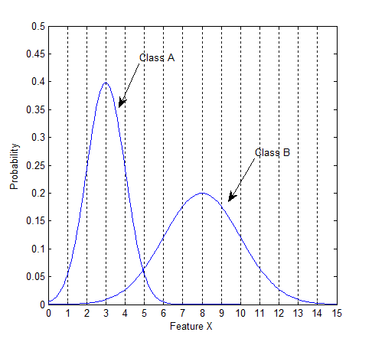
Class Distributions
Notes:
男女 身高分布

Slide 40
Class Distributions

Slide 41

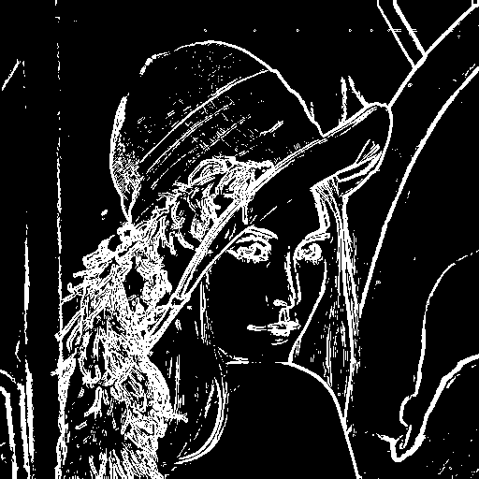
Feature Extraction

Slide 42


Principal Component Analysis
Notes:
降维

Slide 43
2D Example
Data: Gaussian Distribution
Variance: Information
Ellipse: Major Axis vs. Minor Axis
Select the attribute corresponding to the Major Axis
Minor
Major
Feature X₂
Feature X₁

Slide 44
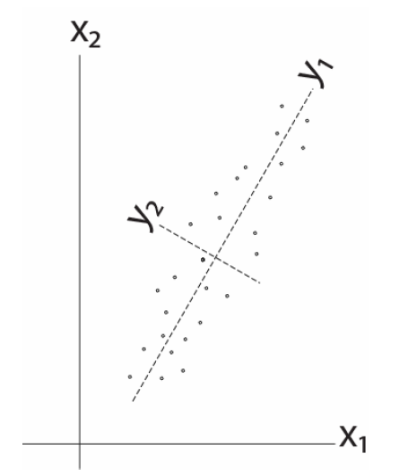
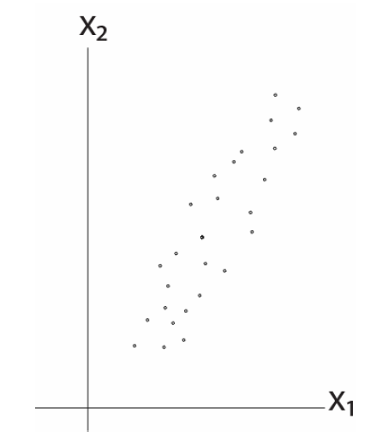
2D Example
Notes:
特征变换，
降维

Slide 45
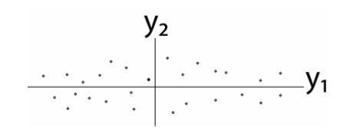
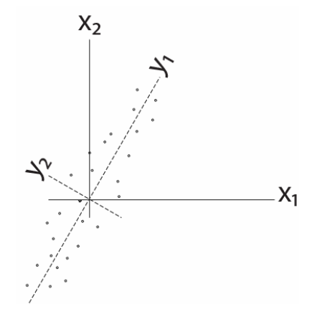
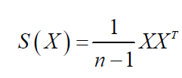
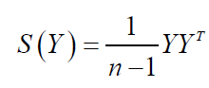
2D Example
Remove correlation

Slide 46
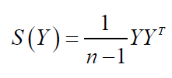
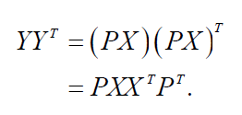
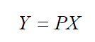
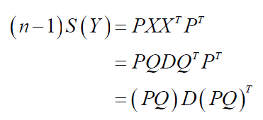


Some Math
Goal: S(Y) has nonzero diagonal entries and all off-diagonal elements are zero.
Eigendecomposition
Notes:
P Q 正交矩阵

Slide 47












A Different View
$$x_{k}$$
e
$$J\left(e\right)=\sum_{i=1}^{n}{{\left\|{x_{k}^{}}^{′}−x_{k}\right\|}^{2}}$$
$$α_{k}=e^{t}x_{k}$$
$${x_{k}^{}}^{′}$$
$$\left\|e\right\|=1$$
$$=\sum_{i=1}^{n}{{\left\|α_{k}e−x_{k}\right\|}^{2}}$$
$$α_{k}$$
$$=\sum_{i=1}^{n}{{α_{k}}^{2}{\left\|e\right\|}^{2}}−2\sum_{i=1}^{n}{α_{k}e^{t}x_{k}}+\sum_{i=1}^{n}{{\left\|x_{k}\right\|}^{2}}$$
$$=−\sum_{i=1}^{n}{{α_{k}}^{2}}+\sum_{i=1}^{n}{{\left\|x_{k}\right\|}^{2}}$$
$$\max_{e}{e^{t}Se s.t. \left\|e\right\|=1}$$
$$=−\sum_{i=1}^{n}{e^{t}x_{k}{x_{k}^{}}^{t}e}+\sum_{i=1}^{n}{{\left\|x_{k}\right\|}^{2}}$$
$$S=\sum_{i=1}^{n}{x_{k}{x_{k}^{}}^{t}}$$
Notes:
投影，代替

Slide 48
More Math ...
eigenvector
eigenvalue
PCA
To project the original data to the eigenvectors of S with the largest eigenvalues.
Notes:
Lagrange Multipliers

Slide 49


PCA Examples
import matplotlib.pyplot as plt
import numpy as np
%matplotlib inline
s = [[1, 0.8], [0.8, 1]]
X = np.random.multivariate_normal([0, 0], s, 10000).T
D, V = np.linalg.eig(s)
newX = V[:,1] @ X
plt.scatter(X[0],X[1])
plt.grid(True)
plt.show()
plt.hist(X[1],50,color='r')
plt.hist(newX, 50, color='g')

Slide 50





Fish

Slide 51


Fish

Slide 52

The Issue of PCA
Now, let’s consider class information ...

Slide 53

Linear Discriminant Analysis
The objective of LDA is to perform dimension reduction while preserving as much of the class discriminatory information as possible.
Given a set of d-D vectors x₁, x₂, ..., x_{n} of which N₁ belong to ω₁, and N₂ to ω₂. Of all the possible projection lines y=w^{T}x, find the one that maximizes the separability.

Slide 54


Measure of Separability

Slide 55


Fisher Criterion
Maximize the distance between classes
Minimize the scatter within each class

Slide 56






Some Math …
between-class scatter
within-class scatter

Slide 57


More Math...
generalized Rayleigh quotient

Slide 58

More Math...
eigenvector problem!
scalar

Slide 59

LDA Example
Dataset
$C1=\left[\left(1,2\right);\left(2,3\right);\left(3,3\right);\left(4,5\right);(5,5)\right]$
$C2=\left[\left(1,0\right);\left(2,1\right);\left(3,1\right);\left(3,2\right);\left(5,3\right);(6,5)\right]$
Covariance of [c1; c2]
$Z=\left[\begin{matrix}2.7636 & 2.2545 \\ 2.2545 & 3.0182\end{matrix}\right]$
Eigenvectors and Eigenvalues of Z
$V=\left[\begin{matrix}−0.7268 & 0.6869 \\ 0.6869 & 0.7268\end{matrix}\right]$
$D=\left[\begin{matrix}0.6328 & 0 \\ 0 & 5.1490\end{matrix}\right]$
The direction of PCA projection: ${\left[0.6869, 0.7268\right]}^{T}$

Slide 60

LDA Example
The mean of each class
$μ_{1}=mean\left(c1\right)={\left[3.0, 3.6\right]}^{T}$
$μ_{2}=mean\left(c2\right)={\left[3.3, 2.0\right]}^{T}$
$S_{B}={\left(μ_{1}−μ_{2}\right)\left(μ_{1}−μ_{2}\right)}^{T}$=$\left[\begin{matrix} 0.11 & −0.53 \\ −0.53 & 2.56\end{matrix}\right]$
The scatter of each class
$S_{1}=4×cov\left(c1\right)=\left[\begin{matrix}10 & 8 \\ 8 & 7.2\end{matrix}\right]$
$S_{2}=5×cov\left(c2\right)=\left[\begin{matrix}17.3 & 16 \\ 16 & 16\end{matrix}\right]$
$S_{w}=S_{1}+S_{2}=\left[\begin{matrix}27.3 & 24 \\ 24 & 23.2\end{matrix}\right]$

Slide 61

LDA Example
${S_{w}}^{−1}S_{B}=\left[\begin{matrix}0.26 & −1.27 \\ −0.30 & 1.42\end{matrix}\right]$
Eigenvectors and Eigenvalues of ${S_{w}}^{−1}S_{B}$
$V=\left[\begin{matrix}−0.98 & 0.67 \\ −0.20 & −0.75\end{matrix}\right]$
$D=\left[\begin{matrix}0 & 0 \\ 0 & 1.69\end{matrix}\right]$
The direction of LDA projection: ${\left[0.6656, −0.7463\right]}^{T}$
Alternatively
${S_{w}}^{−1}{\left(μ_{1}−μ_{2}\right)}^{T}={\left[−0.7936, 0.8899\right]}^{T}$
After normalization: ${\left[−0.6656, 0.7463\right]}^{T}$

Slide 62
LDA Example

Slide 63

C-Class LDA

Slide 64
C-Class LDA
For C-class LDA with C=2, S_{B} is defined as:

Slide 65
C-Class LDA
import matplotlib.pyplot as plt
import numpy as np
%matplotlib inline
N1, N2, N3 = 1000, 500, 2000
X1 = np.random.multivariate_normal([0, 0], [[1,0],[0,1]], N1).T
X2 = np.random.multivariate_normal([3, 6], [[1,-0.8],[-0.8,1]], N2).T
X3 = np.random.multivariate_normal([10, 6], [[1,0.8],[0.8,1]], N3).T
S1= (N1 - 1) * np.cov(X1)
S2= (N2 - 1) * np.cov(X2)
S3= (N3 - 1) * np.cov(X3)
Sw = S1 + S2 + S3
M1, M2, M3 = np.mean(X1, 1), np.mean(X2, 1), np.mean(X3, 1)
Mu = (N1 * M1 + N2 * M2 + N3 * M3)/(N1 + N2 + N3)
Sb = N1*(M1-Mu).T @ (M1-Mu) + N2*(M2-Mu).T @ (M2-Mu)+ N3*(M3-Mu).T @ (M3-Mu)
J = np.linalg.inv(Sw) * Sb
D, V = np.linalg.eig(J)
plt.scatter(X1[0],X1[1])
plt.scatter(X2[0],X2[1])
plt.scatter(X3[0],X3[1])
plt.show()
plt.hist(X1[0], 50, color='r')
plt.hist(X2[0], 50, color='g')
plt.hist(X3[0], 50, color='b')

Slide 66



Limitations of LDA
LDA produces at most C-1 projections
S_{B} is a matrix with rank C-1 or less.
S_{W} may be singular.
LDA does not work well when ...
Notes:
Sw 样本点个数少于维度

